Slide 1

SampleClean: Bringing Data Cleaning into the BDAS Stack
Sanjay Krishnan and Daniel Haas
In Collaboration With: Juan Sanchez, Wenbo Tao, Jiannan Wang, Tim Kraska, Michael Franklin, Tova Milo, Ken Goldberg

Slide 2


Who publishes more?
Notes:
Start with Berkeley vs. Stanford, not the dataset

Slide 3

Microsoft Academic Search
Paper Id | Affiliation
16 | Computer Science Division--University of California Berkeley CA
101 | University of California at Berkeley
102 | Department of Physics Stanford University California
116 | Lawrence Berkeley National Labs <ref>California</ref>
Notes:
Talk more about the dataset/problem/query before jumping into the sources of error

Slide 4
Microsoft Academic Search
Paper Id | Affiliation
16 | Computer Science Division--University of California Berkeley CA
101 | University of California at Berkeley
102 | Department of Physics Stanford University California
116 | Lawrence Berkeley National Labs <ref>California</ref>
X

Slide 5

Microsoft Academic Search
University of California at Berkeley
Computer Science Division
University of California at Berkeley
Computer Science Division
University of California at Berkeley
Department of Physics Stanford
University California
Notes:
Do *not* say ‘algorithms only go so far’!

Slide 6
Enter SampleClean
Data cleaning in BDAS.
Problem 1. Scale
Problem 2. Latency
Sampling to cope with scale.
Asynchrony to cope with latency.

Slide 7
Now it’s your turn!
Be the crowd and help us decide

Slide 8
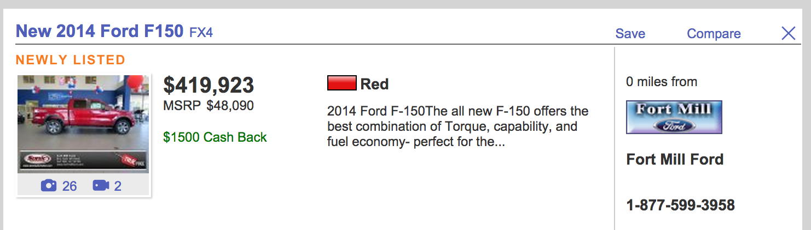
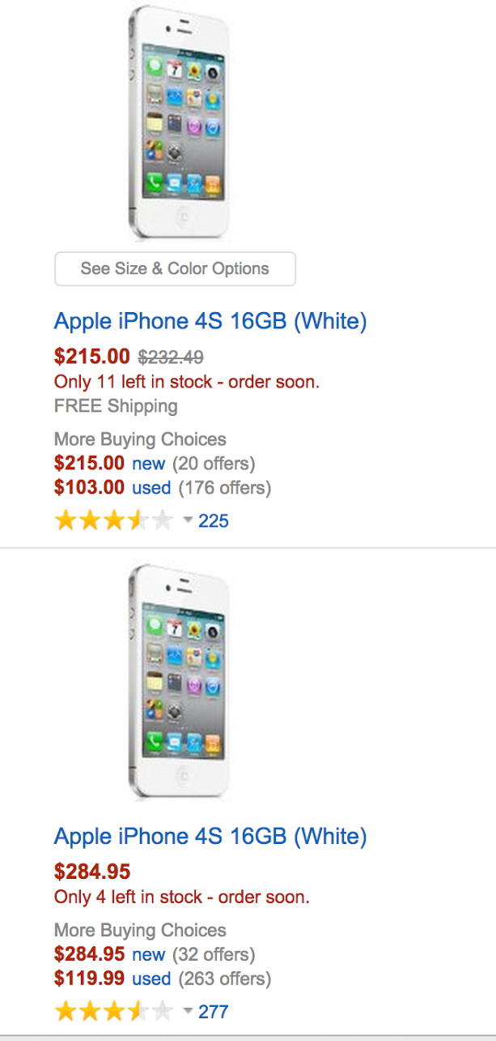

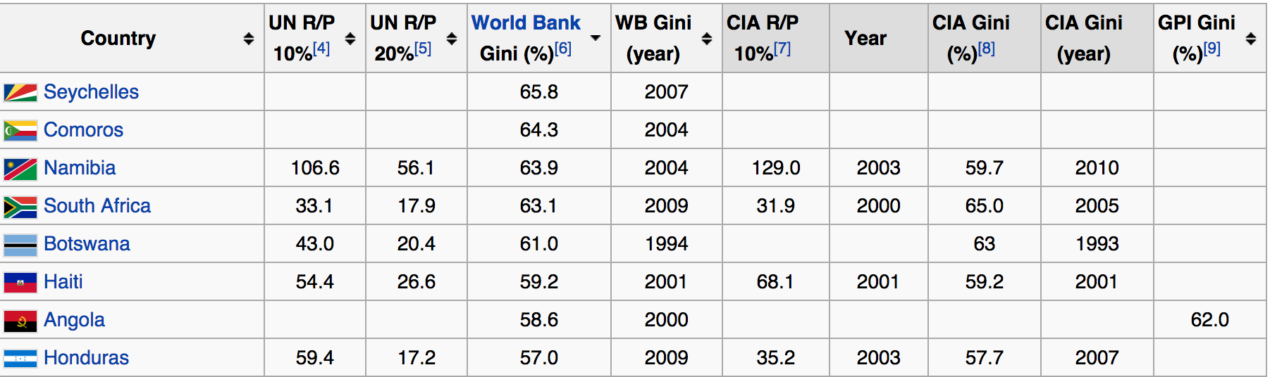
Dirty Data is Ubiquitous
Example: Missing, incomplete, inconsistent data
Notes:
…and can’t be ignored! Analytics on dirty data can lead to incorrect decision-making.

Slide 9
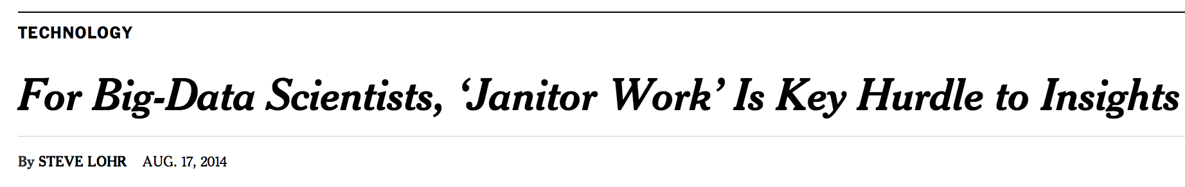
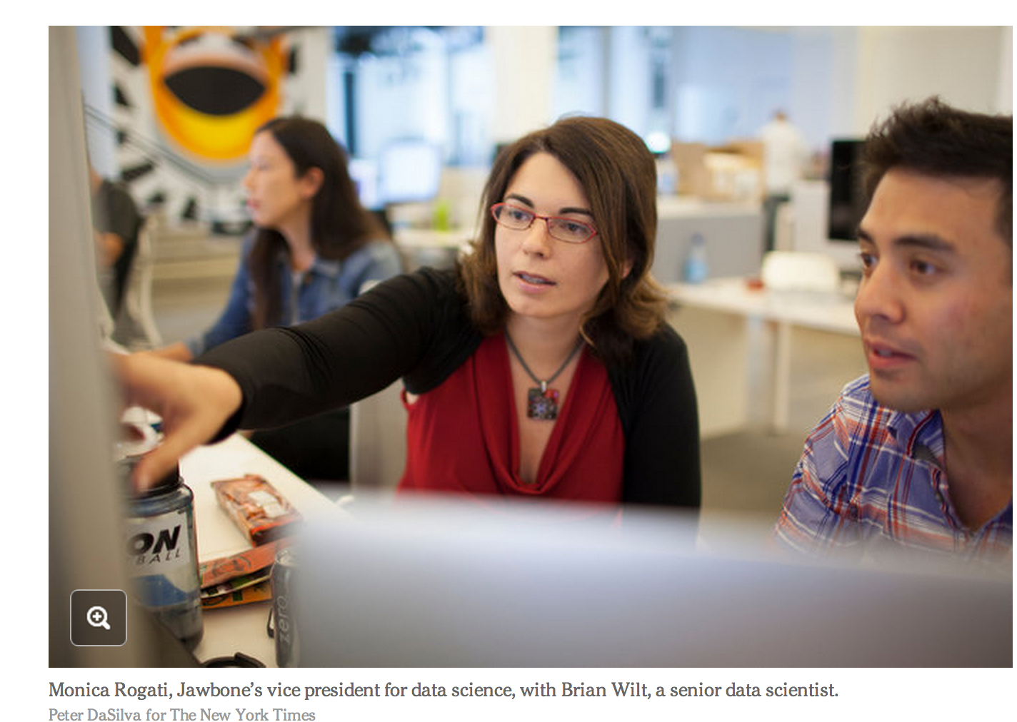
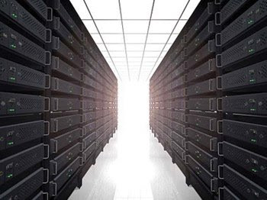







Data Cleaning is Hard
Time consuming
Costly
Domain-specific

Slide 10

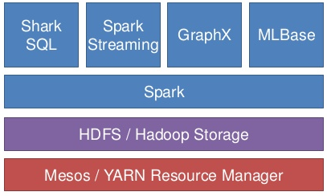
A New Data Cleaning Architecture
Data
Data Cleaning
Analytics

Slide 11
Can it Scale?
People are slow and expensive
Time
Crowd
Machine
Learning
Regex
Notes:
Asynchrony: We allow data cleaning to proceed in the background while analysts make use of the already cleaned data.
Approximation: approximate results are often sufficient, especially for early data analysis tasks such as exploratory data analysis. We leverage sampling / machine learning to provide approximations quickly, then improve our answers as more of the data is cleaned

Slide 12
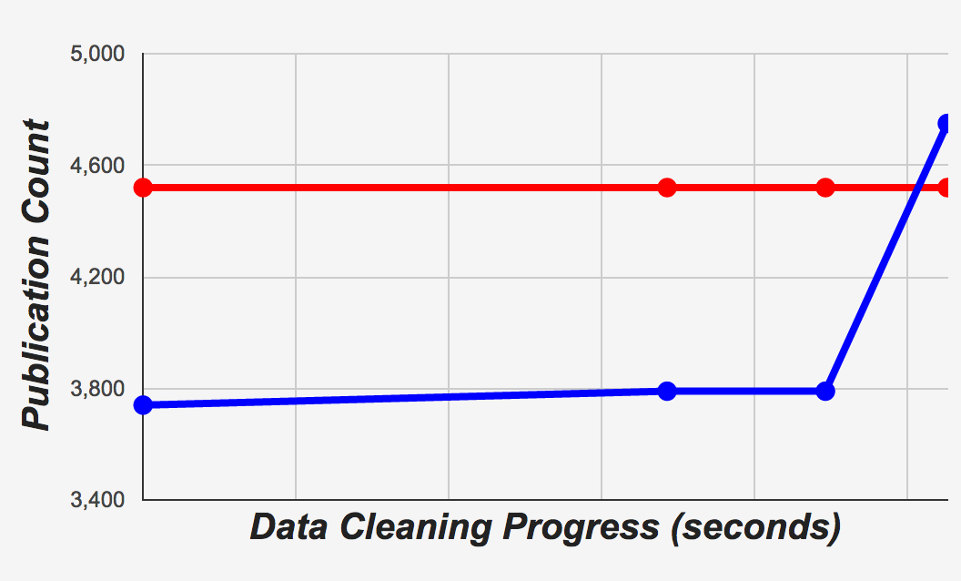
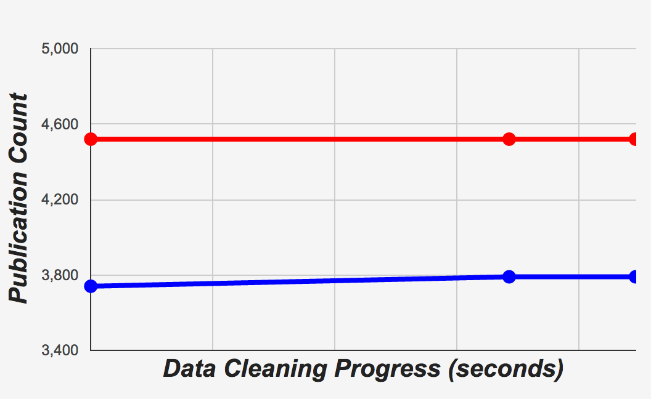
Insight 1: Asynchrony Hides Latency
Notes:
Asynchrony: We allow data cleaning to proceed in the background while analysts make use of the already cleaned data. You saw this in the demo just now—the dashboard issued queries in realtime as the data updated.

Slide 13
Insight 2: Sampling Hides Scale
Query
Error
BlinkDB
Time
Notes:
Approximation: approximate results are often sufficient, especially for early data analysis tasks such as exploratory data analysis. We leverage sampling / machine learning to provide approximations quickly, then improve our answers as more of the data is cleaned.

Slide 14
Insight 2: Sampling Hides Scale
Query
Error
BlinkDB
Data Error
Time
Notes:
Asynchrony: We allow data cleaning to proceed in the background while analysts make use of the already cleaned data.
Approximation: approximate results are often sufficient, especially for early data analysis tasks such as exploratory data analysis. We leverage sampling / machine learning to provide approximations quickly, then improve our answers as more of the data is cleaned.

Slide 15
Insight 2: Sampling Hides Scale
BlinkDB
Query
Error
SampleClean
BlinkDB
Data Error
Time
Notes:
Asynchrony: We allow data cleaning to proceed in the background while analysts make use of the already cleaned data.
Approximation: approximate results are often sufficient, especially for early data analysis tasks such as exploratory data analysis. We leverage sampling / machine learning to provide approximations quickly, then improve our answers as more of the data is cleaned.

Slide 16
SampleClean Data Flow
Query
Dirty Data
Dirty
Sample
Data
Cleaning
Clean
Sample
Sampling
Asynchrony

Slide 17



The SampleClean Architecture
Declare Cleaning
Operations
Issue Queries,
Get Results
Asynchronous Pipelines
Approximate Query Processing
Dirty Sample
Data Cleaning Library
Clean Sample

Slide 18

The SampleClean Architecture
Declare Cleaning
Operations
Issue Queries,
Get Results
Asynchronous Pipelines
Approximate Query Processing
Dirty Sample
Data Cleaning Library
Clean Sample

Slide 19
Approximate Query Processing
Estimate early results and bound with error bars
Query
Error
Time
SampleClean: Fast and Accurate Query Processing on Dirty Data. SIGMOD 2014
BlinkDB: Queries with Bounded Errors and Bounded Response Times on Very Large Data. EuroSys 2013
Notes:
Imagine such a scenario, where you have a large and dirty dataset and cleaning the entire data may spend you a lot of time and money. When using our system, you don’t have to clean the entire data. You can only clean a small sample of the data, then our system will use the results of the cleaning process to understand data error and return a better query result for you. Even better, our system can also bound the query results and tell you that if you clean the entire data, in which ranges your query results will be. If you want to know more details about this sampling feature, you can refer to our latest SIGMOD paper.
We follow the BlinkDB path and only support aggregate queries. We can extend this approach to support more complex queries using non-parametric bootstrap and diagnostics. In addition, we extend the BlinkDB approach to handle data error in addition to query error

Slide 20
The SampleClean Architecture
Declare Cleaning
Operations
Issue Queries,
Get Results
Asynchronous Pipelines
Approximate Query Processing
Dirty Sample
Data Cleaning Library
Clean Sample

Slide 21
Crowds and Machines Work Together
Extensible library of data cleaning tools
Tools are:
Automated
Human-powered
Hybrid
Time
Crowd
Machine
Learning
Regex
Notes:
So in order to require as little work from humans as possible, we use humans to train models that can extrapolate human work to the rest of our data. In particular, we use a technique called active learning, where we have humans clean the most informative bits of data so we can train a better model faster.

Slide 22
Active Learning and Crowds
Choose informative training points
Are these the same?
Stanford Department of IEOR
UC Berkeley Stats
○ Yes
◉ No
Not
Informative
Are these the same?
Department of Mathematics Stanford University
University of California Berkeley Department of Mathematics
○ Yes
◉ No
Informative

Slide 23
Active Learning and Crowds
Choose informative training points
Are these the same?
Stanford Department of IEOR
UC Berkeley Stats
○ Yes
◉ No
Not
Informative
Are these the same?
Department of Mathematics Stanford University
University of California Berkeley Department of Mathematics
○ Yes
◉ No
Informative
Notes:
Point out that we have an extensible general purpose active learning library built on MLLib that can talk to multiple crowds

Slide 24
The SampleClean Architecture
Declare Cleaning
Operations
Issue Queries,
Get Results
Asynchronous Pipelines
Approximate Query Processing
Dirty Sample
Data Cleaning Library
Clean Sample

Slide 25
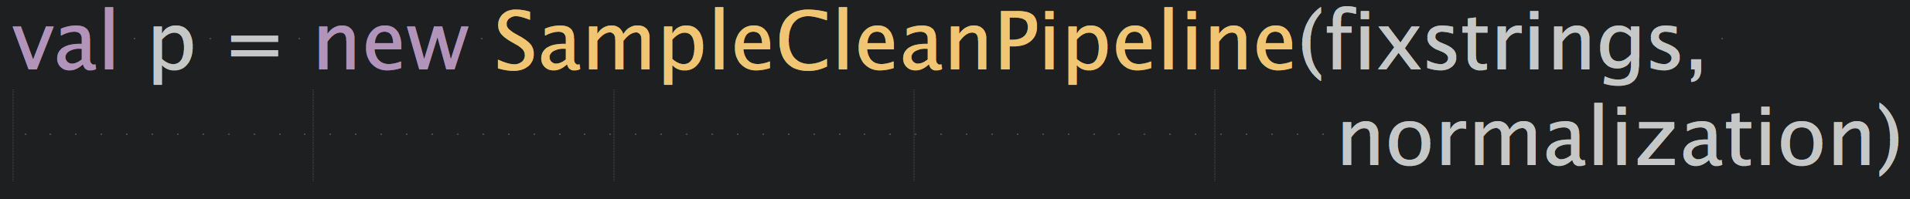
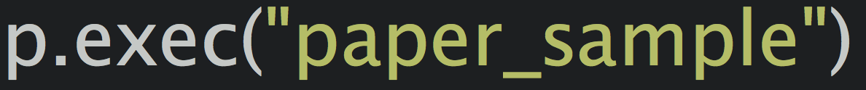
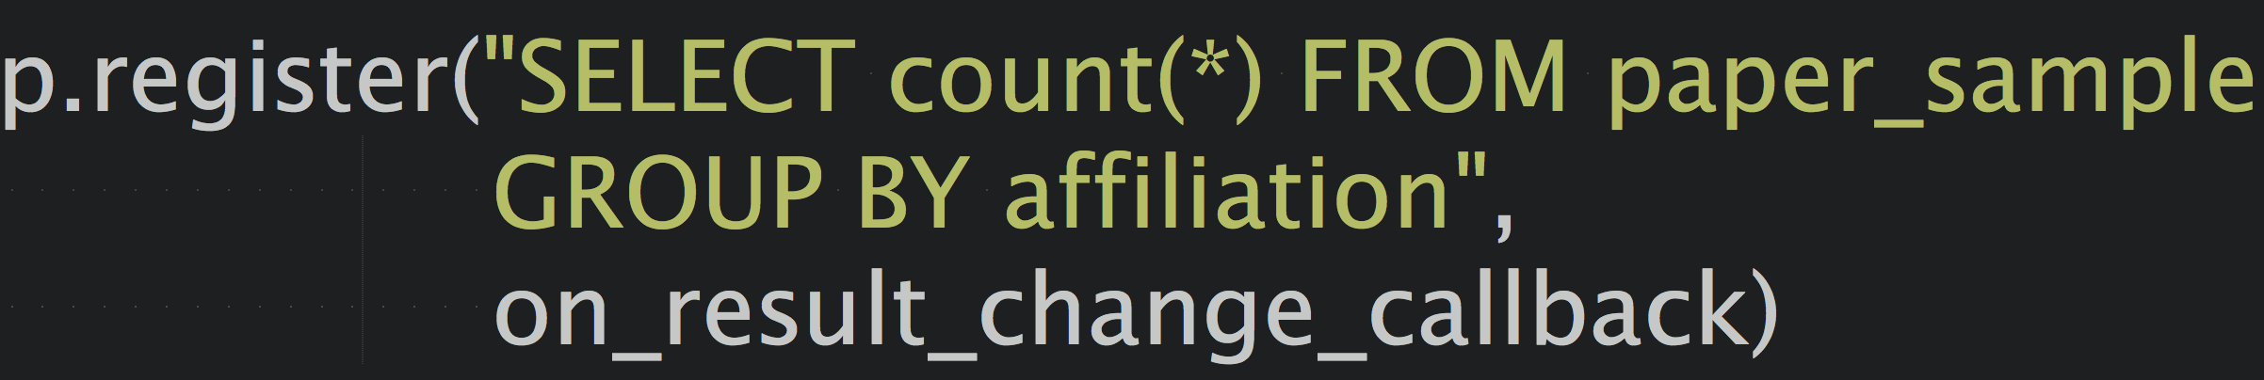
Putting it all together: Asynchronous Pipelines
Users group data cleaning operations into pipelines
Notes:
Talk about executing on a sample samples
Talk about arguments to pipeline

Slide 26
The SampleClean Architecture
Declare Cleaning
Operations
Issue Queries,
Get Results
Asynchronous Pipelines
Approximate Query Processing
Dirty Sample
Data Cleaning Library
Clean Sample

Slide 27
Great, Now What?
Prototype implementation complete!
Significant research challenges remain:
Crowd worker performance and quality
Pipeline semantics and optimization
Programming model and interface
Open source release targeted for next year

Slide 28
Summary
Data Cleaning is slow, costly, and domain-specific
SampleClean brings data cleaning into the BDAS stack
SampleClean uses asynchrony to hide latency, and sampling to hide scale
SampleClean combines Algorithms, Machines, and People, all in one system

Slide 29
Asynchrony in Spark
The Spark abstraction: blocking BSP
So how do we achieve asynchrony?
Multithreaded master
Intermediate results materialized in Hive
Standalone Finagle HTTP server for crowd work

